Slide 1

Denoising Diffusion Probabilistic Models
Amenta Daniele – D’Agosta Daniele
a.a. 2021-22

Slide 2
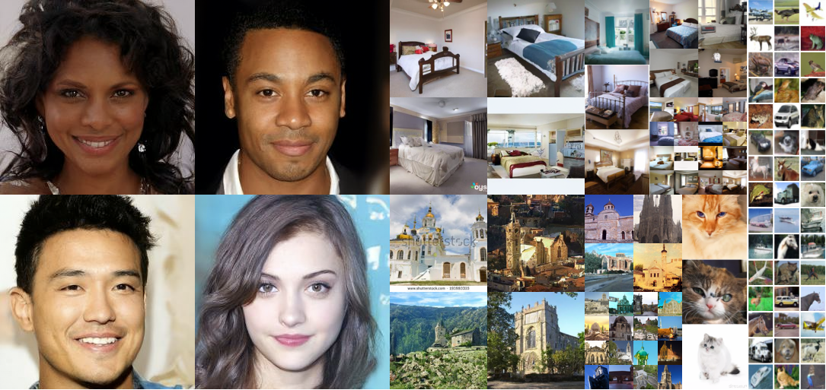
Diffusion Probabilistic Models
Diffusion probabilistic models are a class of latent variable models inspired by considerations from nonequilibrium thermodynamics.
Diffusion models are a kind of generative models that are increasingly studied and analyzed since, compared to the GAN and VAE networks, they are easier to train.

Slide 3
The key concept
If we could build a learning model capable of learning the systematic decay of information due to noise, then it should be possibile to reverse the process and thus retrieve the information from noise.

Slide 4
The key concept
We can distinguish two processes:
Forward process
Reverse process
The general concept is to sequentially destroy information in a series of data through a forward process. A model is then trained to reverse this dissemination process and retrieve the information (reverse process).
This method allows models to learn and sample efficiently. The sampling process allows the generation of realistic data through the Markov chain, conditioned by white noise.

Slide 5
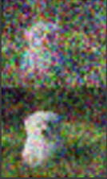
The key concept
1. A timestamp is selected at random, and the appropriate amount of Gaussian noise is sampled and added to the image.
2. Neural network learns denoising process, given a noisy image and the noise scheduler’s timestep.

Slide 6
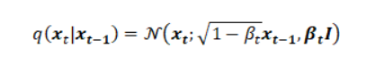
Forward process
In this process the gaussian noise is introduced until the data becomes all noise.
We can formally define the forward diffusion process as a Markov Chain and therefore, unlike an encoder in the VAEs it doesn’t require a training. Starting with the initial data point , we add Gaussian noise for T successive steps, and obtain a set of noisy samples. The prediction of probability density at time t is only dependent on the immediate predecessor at time t-1 and therefore, the conditional probability density can be computed as follows:

Slide 7
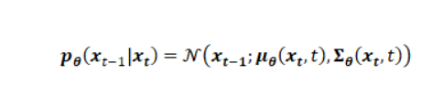
Reverse process
This process cancel noise by learning conditional probability densities using a neural network model.
The reverse process requires the estimation of probability density at an earlier time step given the current state of the system.
Unlike the forward process, the estimation of previous state from the current state requires the knowledge of all the previous gradients which we can’t obtain without having a learning model that can predict such estimates.

Slide 8
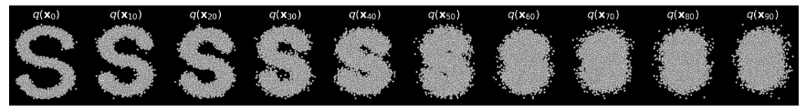
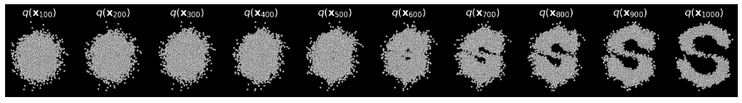
Results of the two processes
Figure 1: Results of a forward Diffusion process on synthetic dataset of S-Curve
Figure 2: Results of reconstruction of data from isotropic Gaussian noise

Slide 9
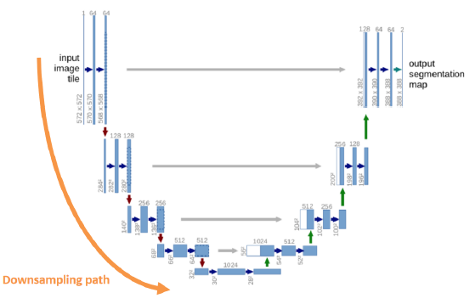
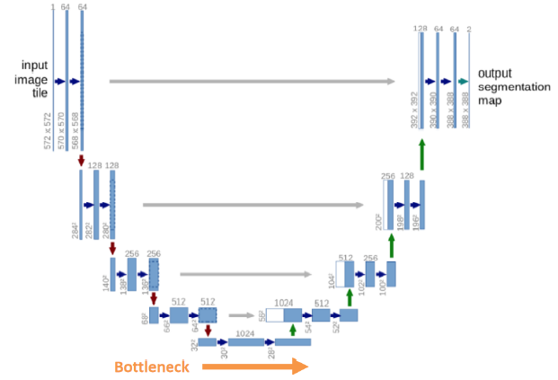
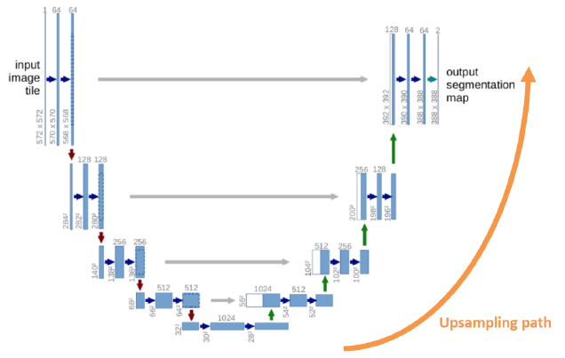
Architecture (U-Net)
The authors of the Denoising Diffusion Probabilistic Models have opted for a U-Net which are composed of the following paths:
Downsampling path: the size of the images is reduced by convolution, i.e. the information is compressed;
Bottleneck: image features are processed;
Upsampling path: transposed convolution is applied to increase the size of the images.

Slide 10
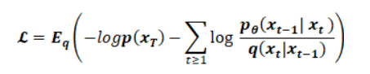
Loss function
The goal of the network model is to optimize the loss function defined as follows:
In our neural network we could choose to use MAE (Mean Absolute Error) or MSE (Mean Square Error) as the loss function.
In accordance with the choices of the authors, we made use of the MAE.

Slide 11
Loss function
Efficient training is therefore possible by optimizing random terms of L with stochastic gradient descent. Further improvements come from variance reduction by rewriting L as:
These considerations are drawn from the material by Sohl-Dickstein et al.

Slide 12
Metrics: FID
A popular metrics to evaluate generative models is the FID (Fréchet inception distance), which evaluate the distance between the feature vectors of real images and fake images.
The FID score is used to evaluate the quality of the images generated by the GAN.

Slide 13
Metrics: IS
Another important evaluation parameter is the IS (Inception Score), obtained from a neural network pre-trained by Google that returns the degree of distinction of the elements present within an image.
A higher score is better, because it means that your GAN can generate many different distinct images.

Slide 14
Metrics: preliminary work
The code provided by the authors of the paper implements the algorithm, but the code is not enough for the calculation of the aforementioned metrics.
In order to calculate these metrics, we made use of code outside the provided repositories.

Slide 15
Experimental details
This neural network architecture follows the backbone of PixelCNN++, which is a U-Net based on Wide ResNet.
The authors replaced the wight normalization with a group normalization to make the implementation simpler.

Slide 16
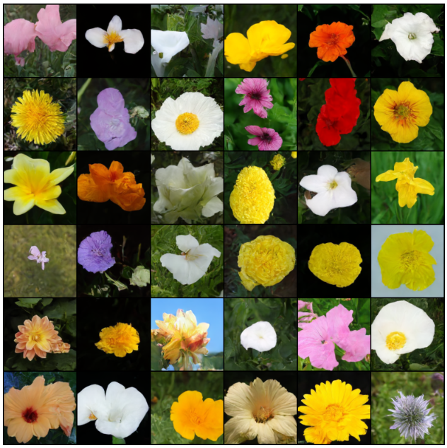
Dataset
Regarding the dataset supplied in input, it consists of images scaled linearly in [-1, 1].
For our case, CIFAR10 was used, even if the paper in question also uses LSUN and CelebA-HQ to reach the conclusions. Each input image is resized to the same size. The images all have the same resolution configurable in the model parameters, which we configured at 128x128.

Slide 17
Dataset
The dataset is composed of the Trainer class which takes in the folder where the images are located and the respective image size.
The dataset is created using a series of preprocessing operations: random horizontal flips (which can be configured as a class parameter), rescaling and normalization in the interval [-1.1].
Furthermore, a data shuffle is applied, in order to avoid that the order of the information can influence the learning of the model.

Slide 18
Choice of hyperparameters
Apart from an initial choice of hyperparameters early on to make network size fit within memory constraints, the authors performed the majority of hyperparameter search to optimize for CIFAR10 sample quality, then transferred the resulting settings over to the other datasets.
Dropout rate;
Random horizontal flips;
Optimazer;
Learning rate;
Batch size;
EMA (decay factor).

Slide 19
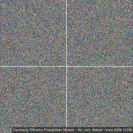
Sampling
The model proceeds to generate new images starting from diffusion models by applying the diffusion process in reverse.
We start from T, where from the Gaussian distribution model there is only noise and then we make use of the neural network in order to completely remove it, until we arrive at the time step t = 0.

Slide 20
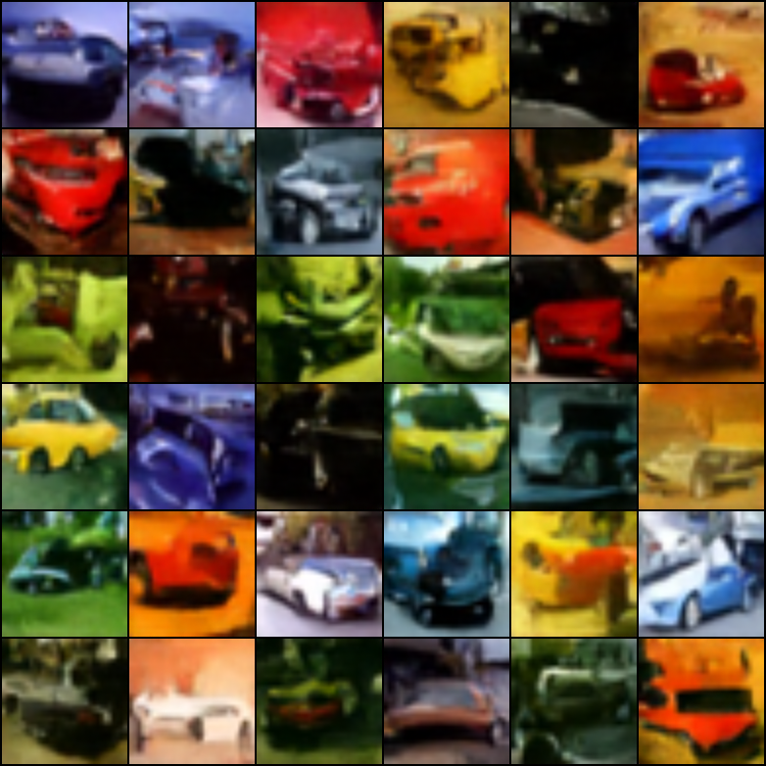
Our results
Learning rate: 1 x 10⁻⁴
EMA decay: 0.995
Batch size: 32
Training steps: 10.000
Loss function: 0.0606
FID: 13.17
IS: (1.38, 0.19)
Exec. time: 6h

Slide 21
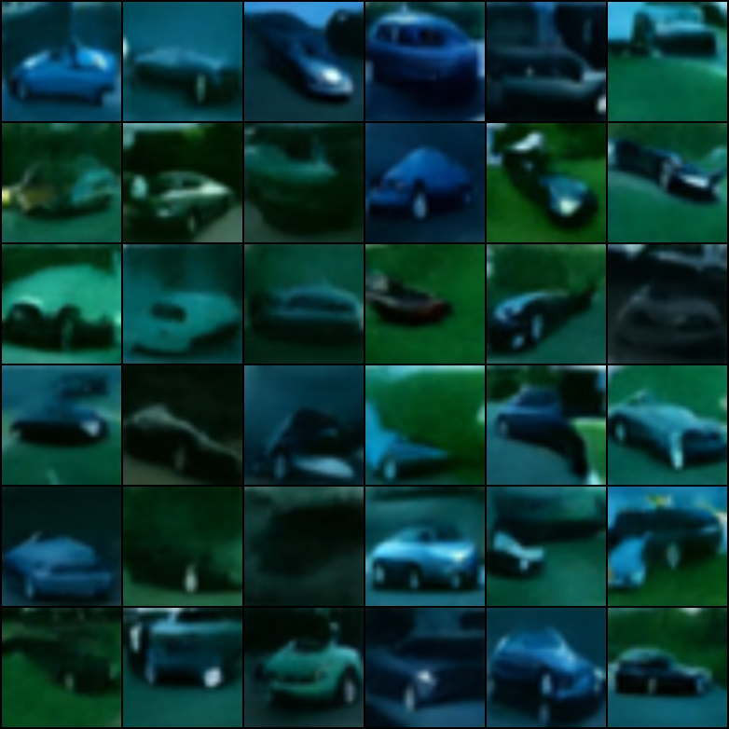
Our results
Learning rate: 1 x 10⁻⁴
EMA decay: 0.999
Batch size: 32
Training steps: 14.000
Loss function: 0.0539
FID: 10.7
IS: (3.47, 0.82)
Exec. time: 8h 50m
⬇️
⬇️
⬆️

Slide 22
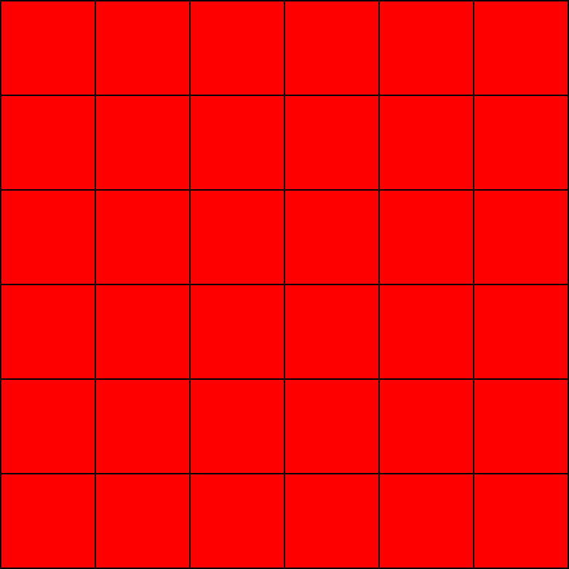
Our results
Learning rate: 0.01
EMA decay: 0.999
Batch size: 32
Training steps: 10.000
Loss function: NAN
FID: 7.50
IS: (1.00, 4.90)
Exec. time: 6h 15m
❌
⬇️
⬇️

Slide 23
Model: our doubt
The authors claim to have achieved far better results, but:
the algorithms used for the calculation of metrics such as FID and IS have not been provided, so it is possible that the results obtained by us are influenced by the algorithm used.

Slide 24
Our opinions: what worked?
✅
The model presented by the authors of the paper allows the generation of high-quality images.
Such diffusion models could become very useful for data compression processes, as the data becomes more and more high resolution. The work of the authors of this paper could also contribute to representation learning based on unlabeled data, for example for image classification.

Slide 25
Our opinions: what could be improved?
❌
The paper suffers from «an overload of references» that the reader needs to look into, in order to understand the key processes.
Some parameters were tested «experimentally», but the ideal values found by the authors are missing from the paper, and there is generally scarse clarity on how the tests were conducted.
The authors-provided code is missing any comment.

Slide 26
Thank you!

